Slide 1
Mini Project- Easy Housing Solution
Group Number 2
GLC-G103,Talwade,Pune
7th January,2019
Notes:
Copyright © 2011 IGATE Corporation (a part of Capegemini Group). All rights reserved.
No part of this publication shall be reproduced in any way, including but not limited to photocopy, photographic, magnetic, or other record, without the prior written permission of IGATE Corporation (a part of Capegemini Group).
IGATE Corporation (a part of Capegemini Group) considers information included in this document to be confidential and proprietary.

Slide 2
Team Members
Kajal Rajendra Pawar - 164284
Keerthana K N - 164292
Mayuri Manohar Mhatre - 164300
Mohd Saleem Khan - 164302
Mohit Kishore Asrani - 164307
Nelaturi Gopala Krishna Reddy - 164305
Nikhitha Kamath - 164306

Slide 3
Project Details
This project is aimed at developing Easy Housing Solution (EHS) for administrators and Customers.
It is proposed to develop a system to provide web based Housing Solution system which will allow users to study, compare, buy, sell & then maintain his/her property details in a systematic way.
Typical operations include registering and login of the user, searching houses for buying or renting.
Owners can add their property, upload images from the Easy Housing company.
Technology Used:
Presentation Layer : WPF 4.5
Business Layer : C# 5.0
Database Layer : SQL Server 2012

Slide 4
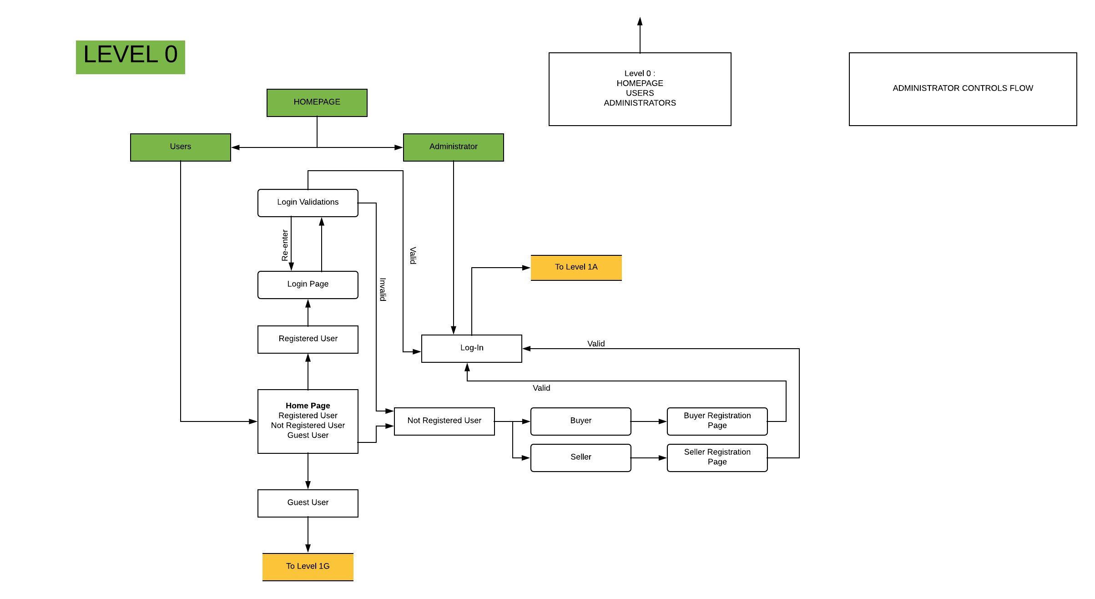
Diagram Depicting Entire Project
Fig 2.1

Slide 5
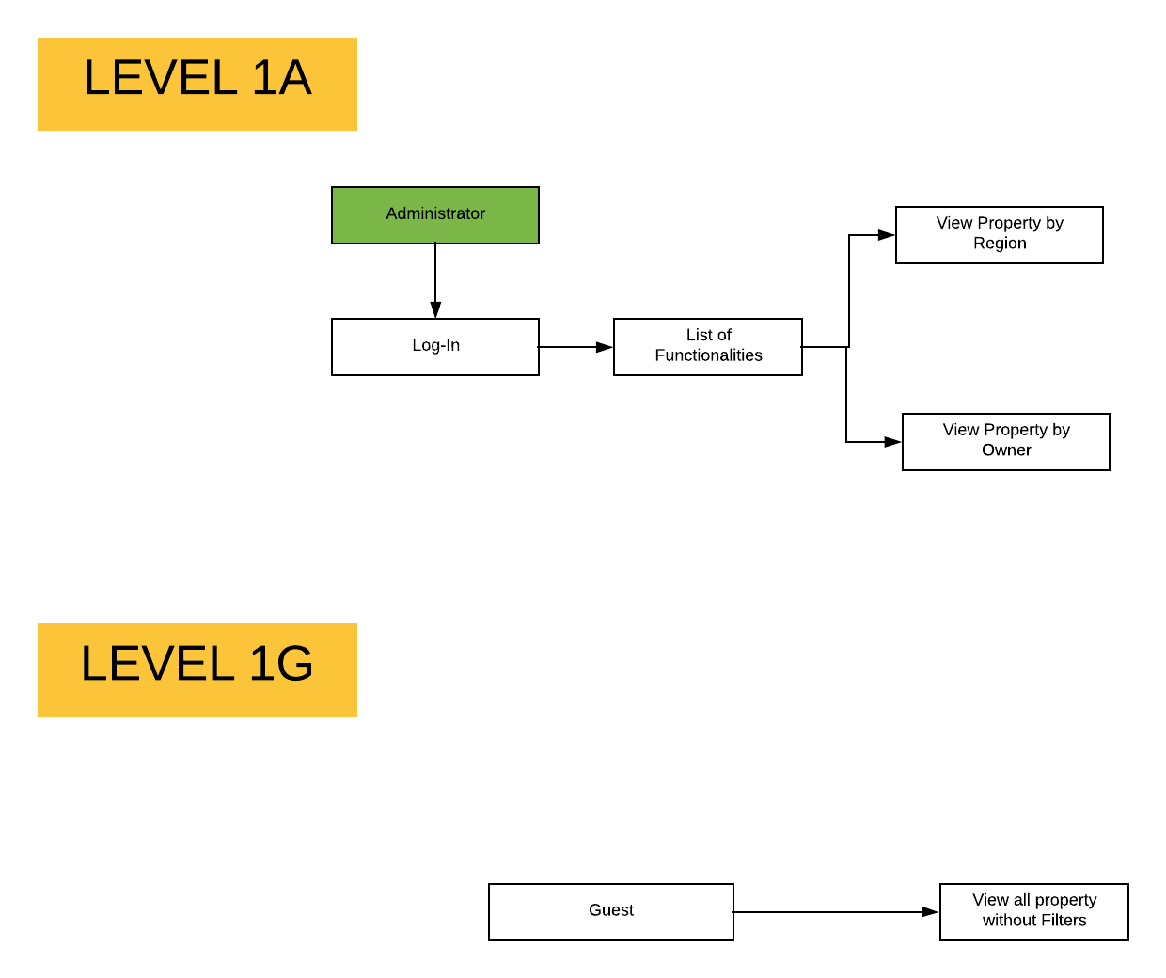
Fig 2.2

Slide 6
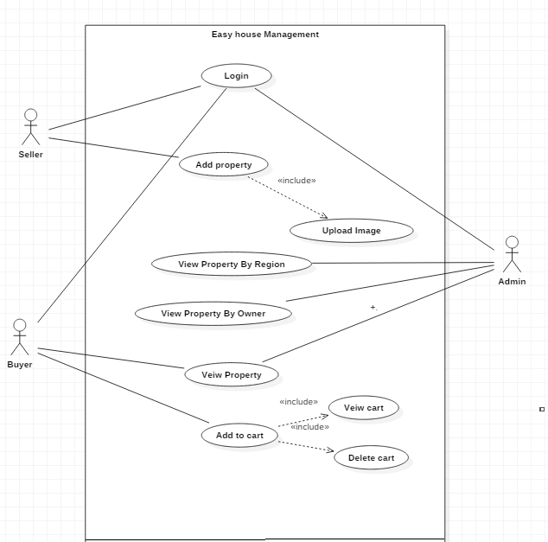
Use Case Diagram
Fig 2.3

Slide 7
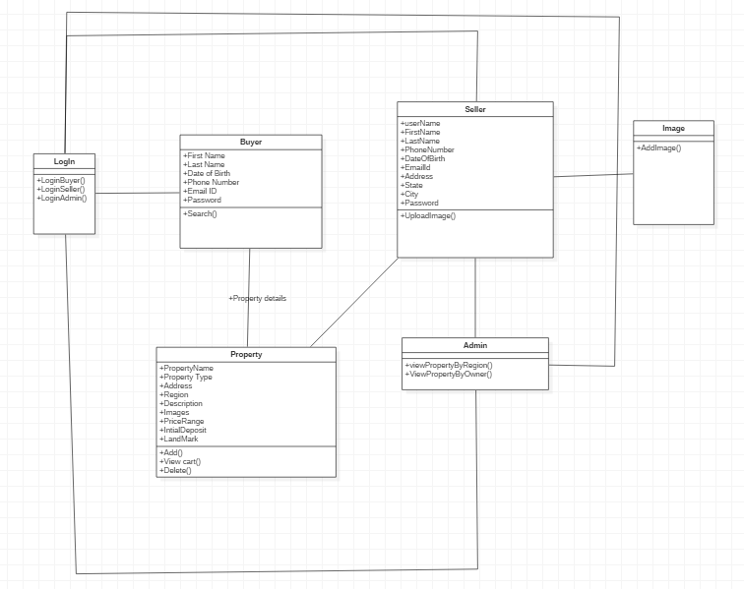
Class Diagram
Fig 2.4

Slide 8
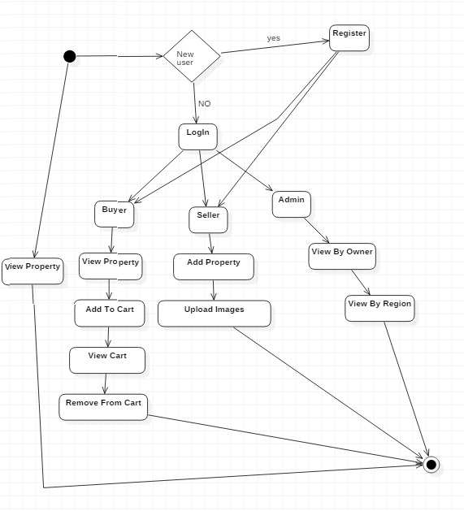
Sequence/Activity Diagram
Fig 2.5

Slide 9
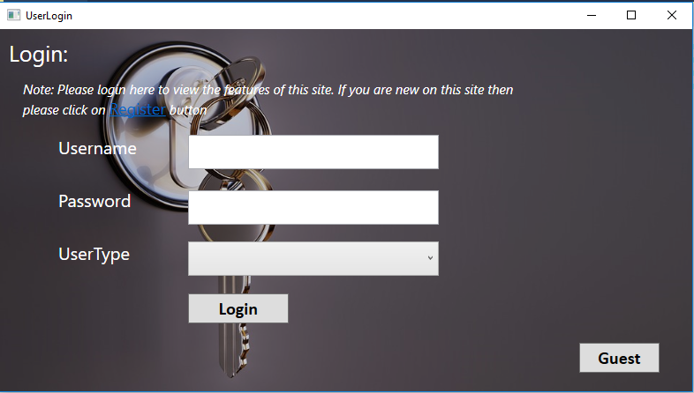
Screen shots
Fig 2.6

Slide 10
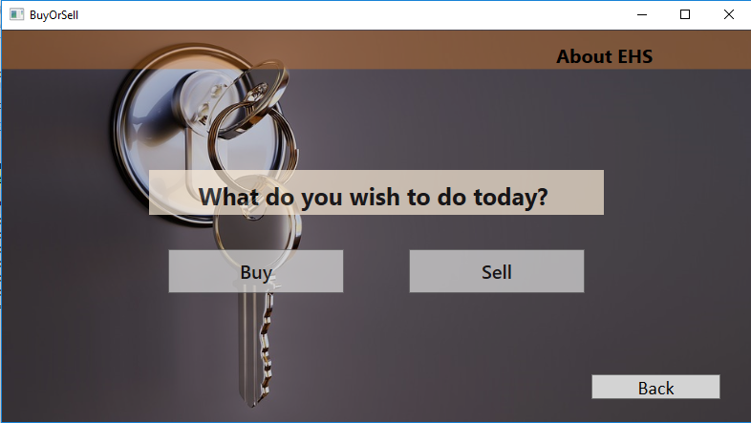

Slide 11
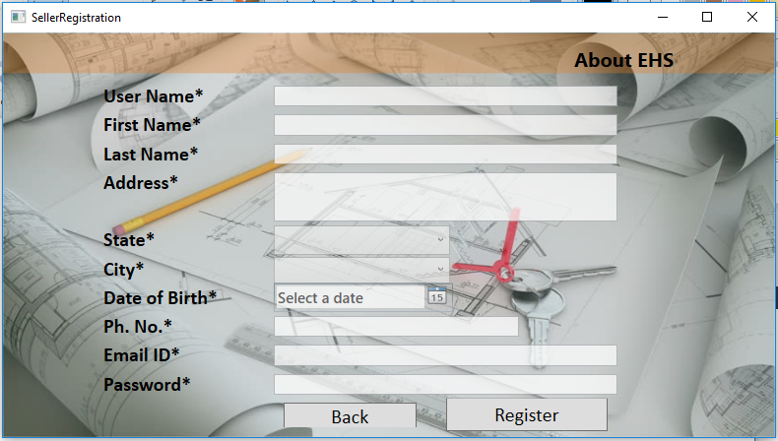

Slide 12
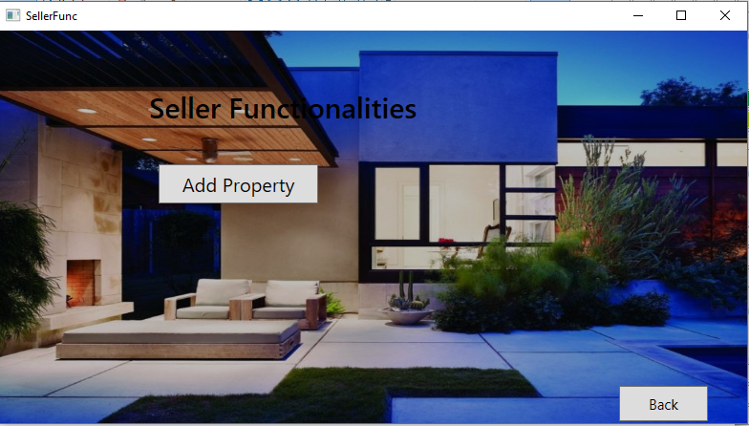

Slide 13
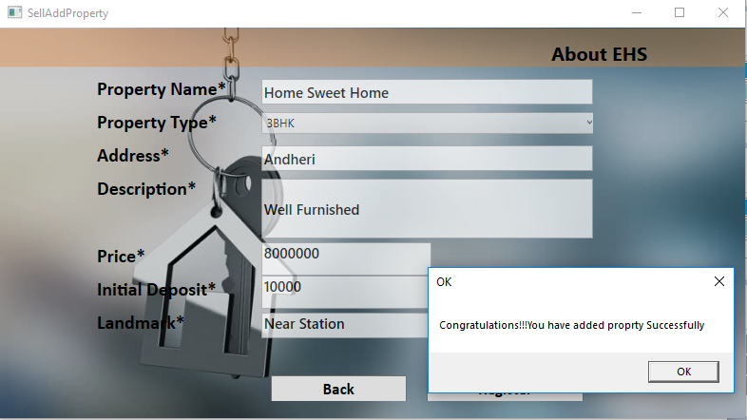

Slide 14
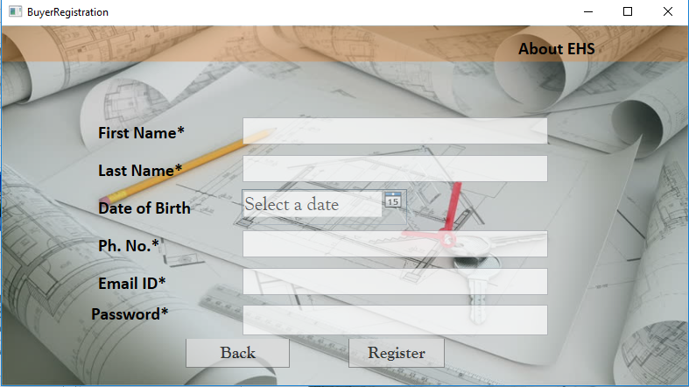
Screen shots
Fig 2.7

Slide 15
Future Enhancements
Sort by View: We can select the property by view like on Beach side , Lake Side , etc .
Sort by Cost Range: According to the comfort , user can select the property by Cost.
Sort by Area : User can sort even by the per square feet area.

Slide 16
Thanks

